Slide 1
Moving Forward: Print Media at The CI View
Presented by Sergio Mercado to the ASI Board of Directors on March 4, 2021

Slide 2
Recent History:
Fall 2020 – Spring 2021
Fall 2021 – Spring 2022
Started the Weekly edition (E-Newsletter)
Ramped up Broadcasting/Social Media
Continued Weekly and Broadcasting
Brought back paper as “Special Edition”
Fall 2019
Spring 2020
Monthly Printed Paper
Shift to Digital Paper

Slide 3
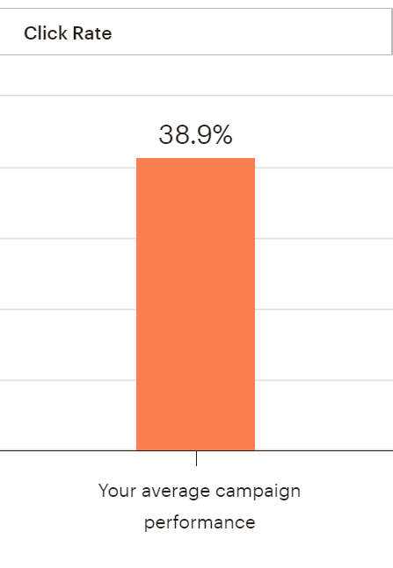
Success of the Weekly
More rapid news communication
High reader engagement
10,383 subscribers
Average open rate: 38.9% = 4039 subscribers
Industry Standard: 27%
Better feedback from students, faculty, staff, etc.
Many vendors placing multiple ads
To date we have 74 ads booked for this academic year

Slide 4
The Print Paper
Not able to print timely news
Low Engagement
Printing only 1000 copies for a campus of 7000 students and not even 50% are picked up
Art classes have been known to take the printed paper to line their paint tables
Few interested vendors
For both printed papers this year, only 3 vendors for a total of 4 ads

Slide 5
Digital vs Print Ad Sales
Digital ad capacity: $205
Average booked per Weekly: 3-4
How much could be made in a year (26 issues): $5,330
Made so far this year: $2,900
Annual cost: $1,020 (Mailchimp)
Print Ad Capacity: $740
Average booker per Print: 2
How much could be made in a year (1 edition/semester): $1,480
Made so far this year: $1,200
Annual cost: $2528 ($632 per issue)

Slide 6
Obstacles to producing print
Longer production time
Two to Three months to produce
Different skill set necessary
Organization is largely volunteer membership
Not Timely
Hinders ability to focus on current news

Slide 7
Executive Summary
The CI View has found success in the digital multimedia news spaces
The Weekly, Social Media and Broadcasting
Digital news allows for greater potential in ad sales and greater engagement with readers
Most print newspapers across the country are converting to digital only
Focusing on digital news will allow more growth for the future
For these reasons, we are discontinuing print editions

